Slide 1

AHA 2025 VESALIUS-CV Primary Results Presentation Slides
©2025 Amgen Inc. All rights reserved.
SC-AT-AMG145-01328 1125

Slide 2
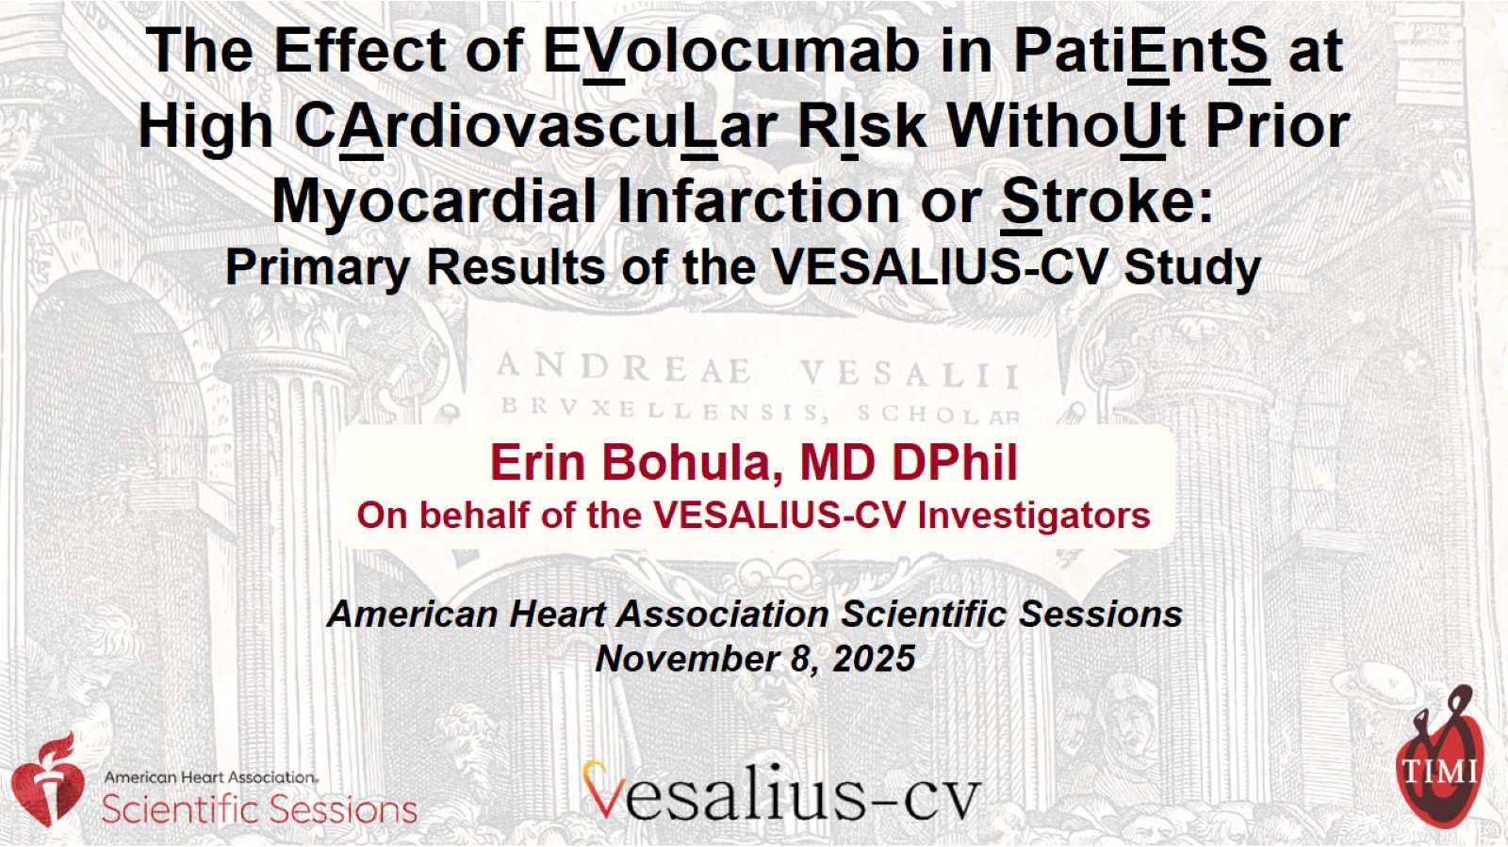
The Effect of EVolocumab in PatiEntS at High CArdiovascuLar RIsk WithoUt Prior Myocardial Infarction or Stroke:
Primary Results of the VESALIUS-CV Study

Slide 3
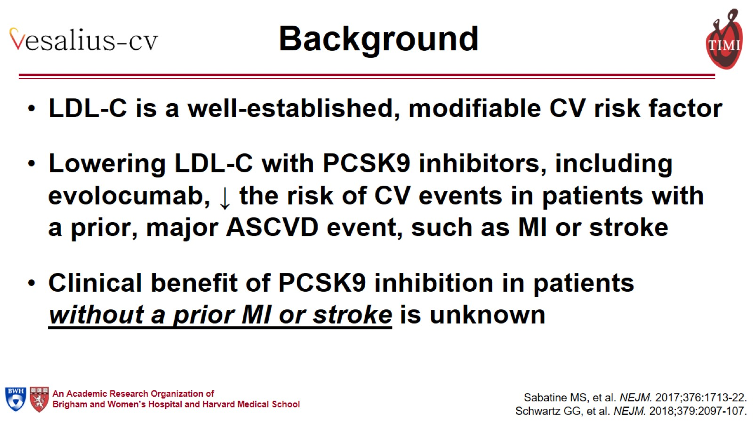
Background

Slide 4
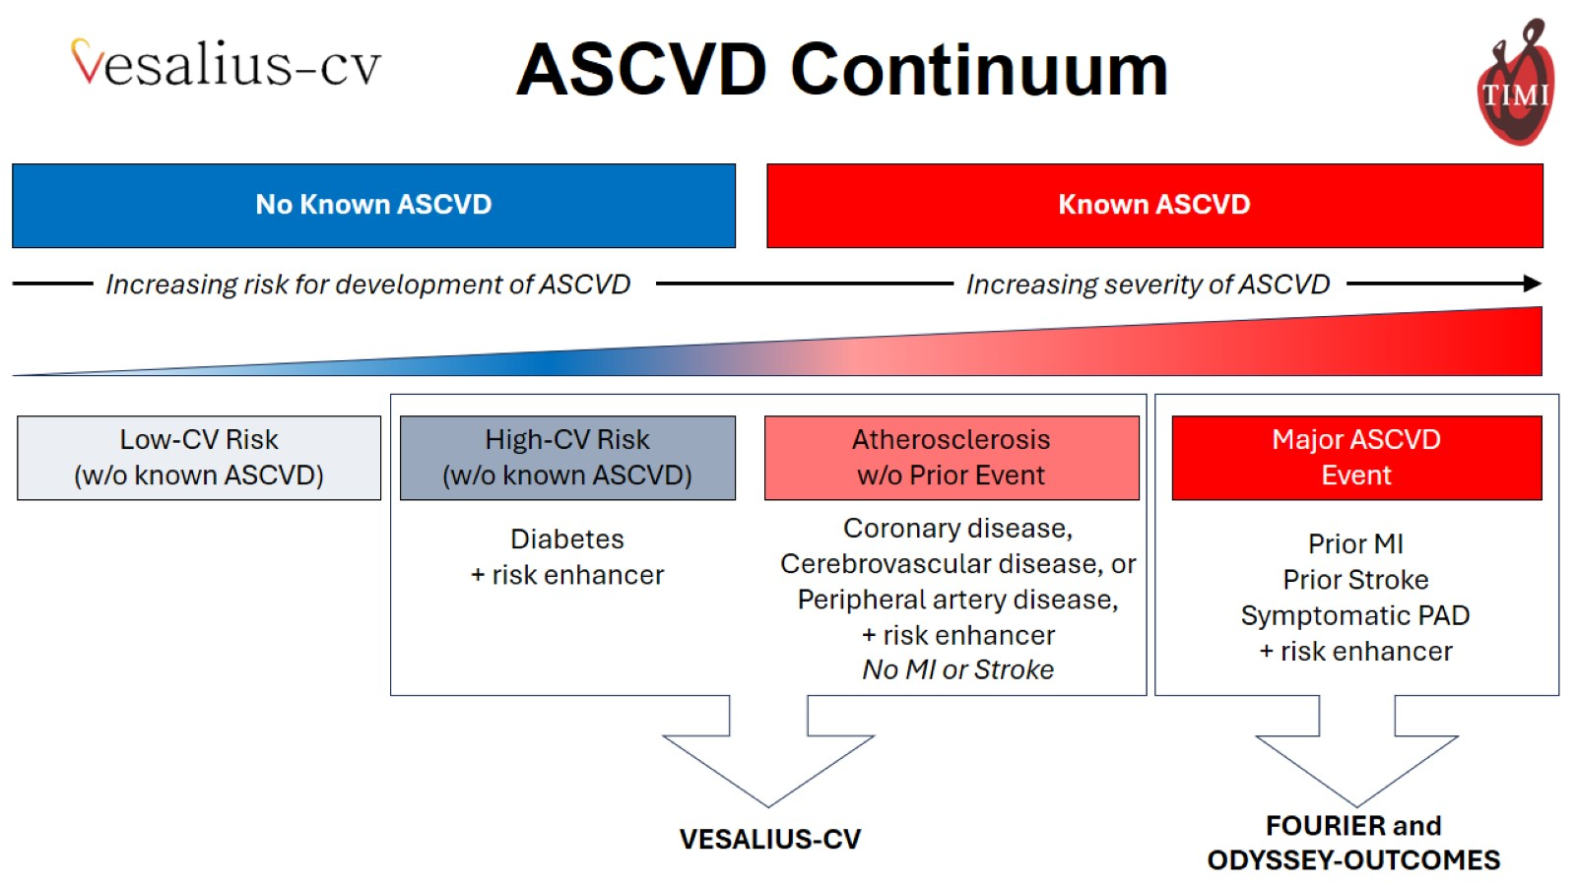

Slide 5
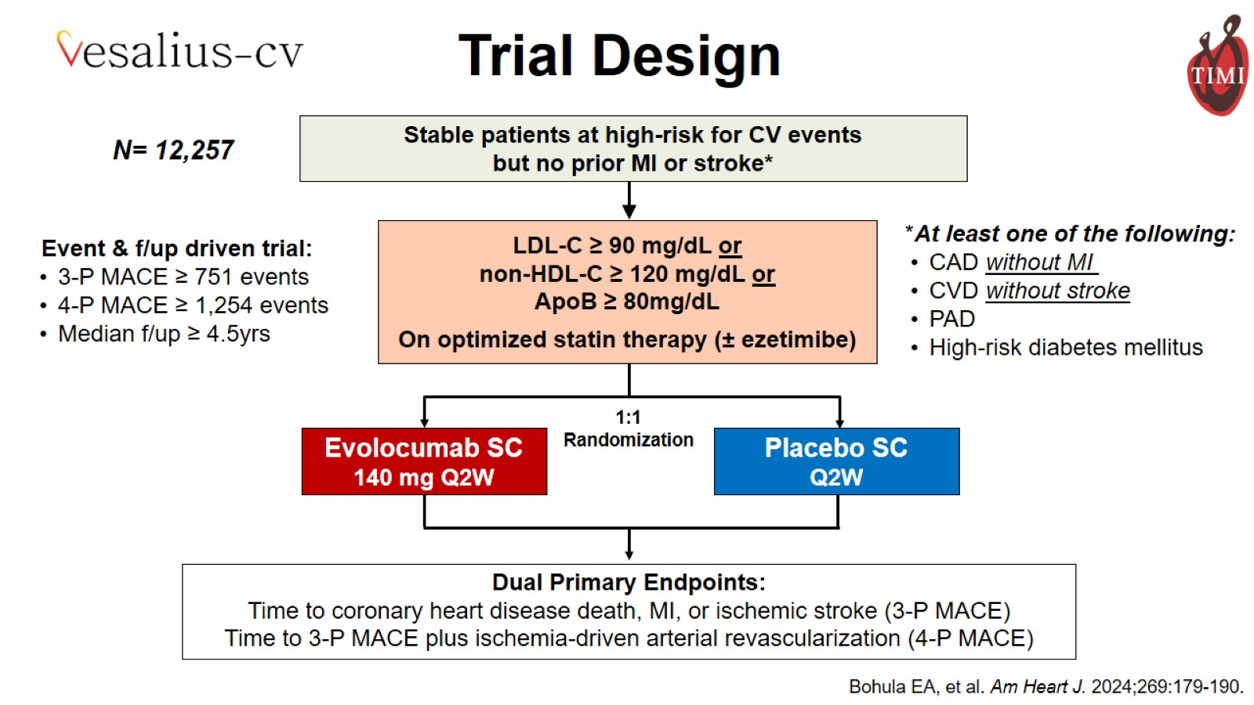

Slide 6
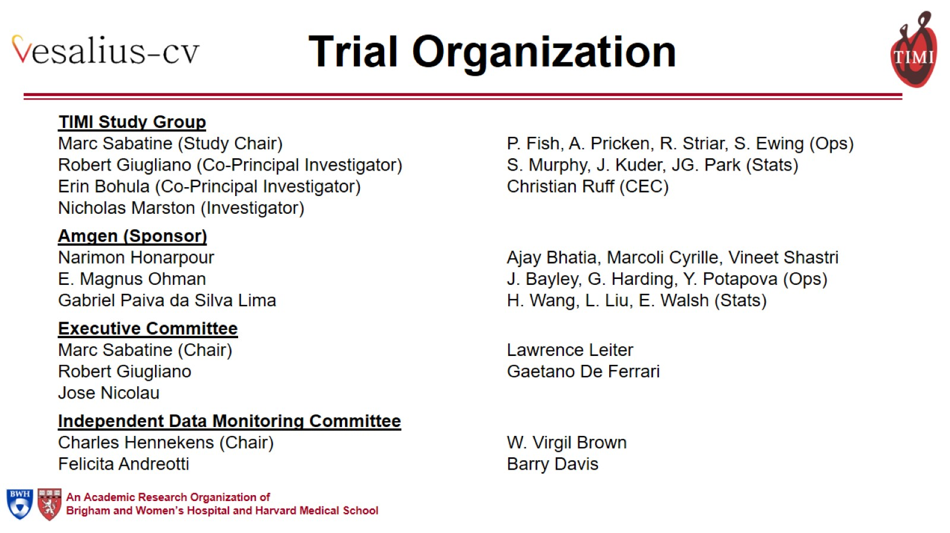
Trial Organization

Slide 7
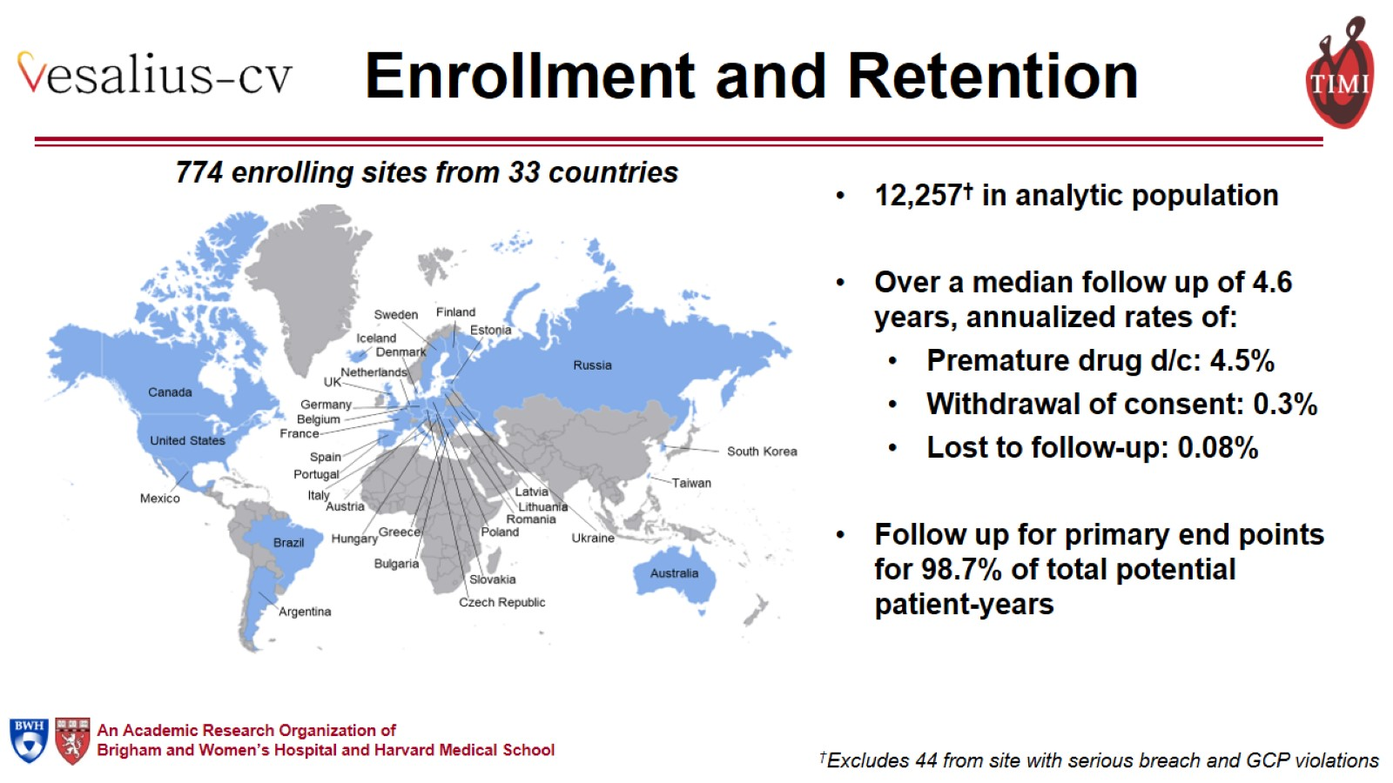
Enrollment and Retention

Slide 8
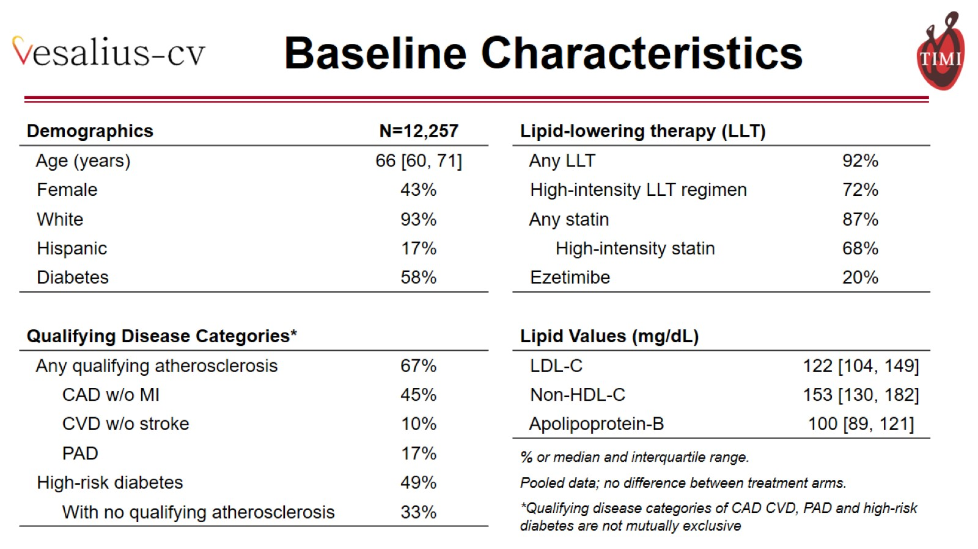
Baseline Characteristics

Slide 9
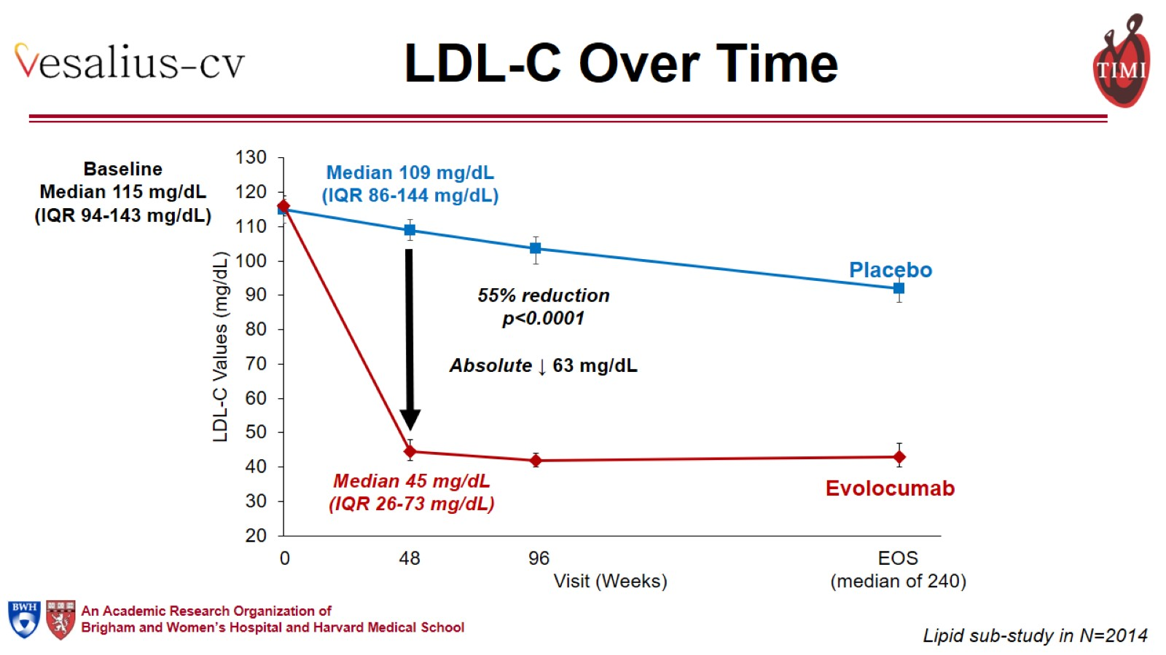
LDL-C Over Time

Slide 10
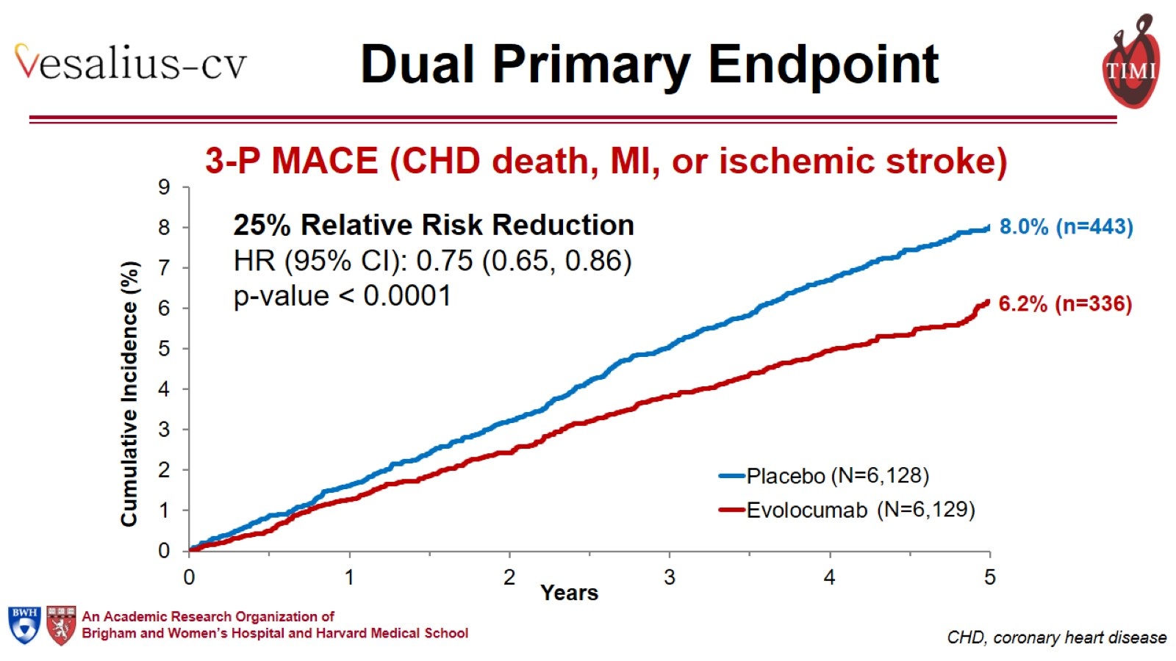
Dual Primary Endpoint

Slide 11
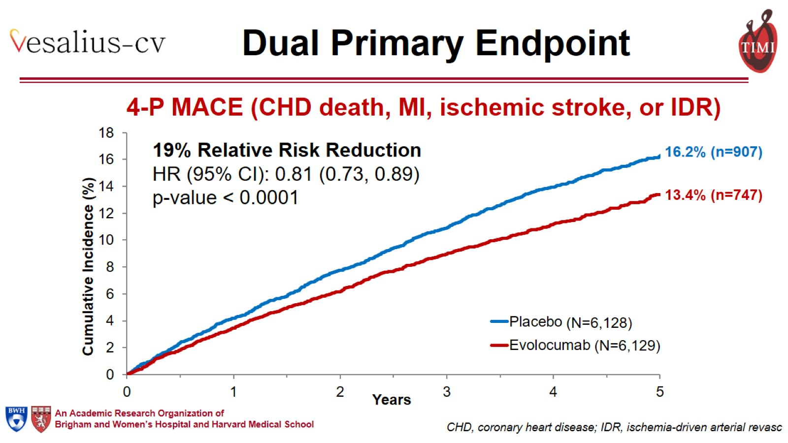
Dual Primary Endpoint

Slide 12
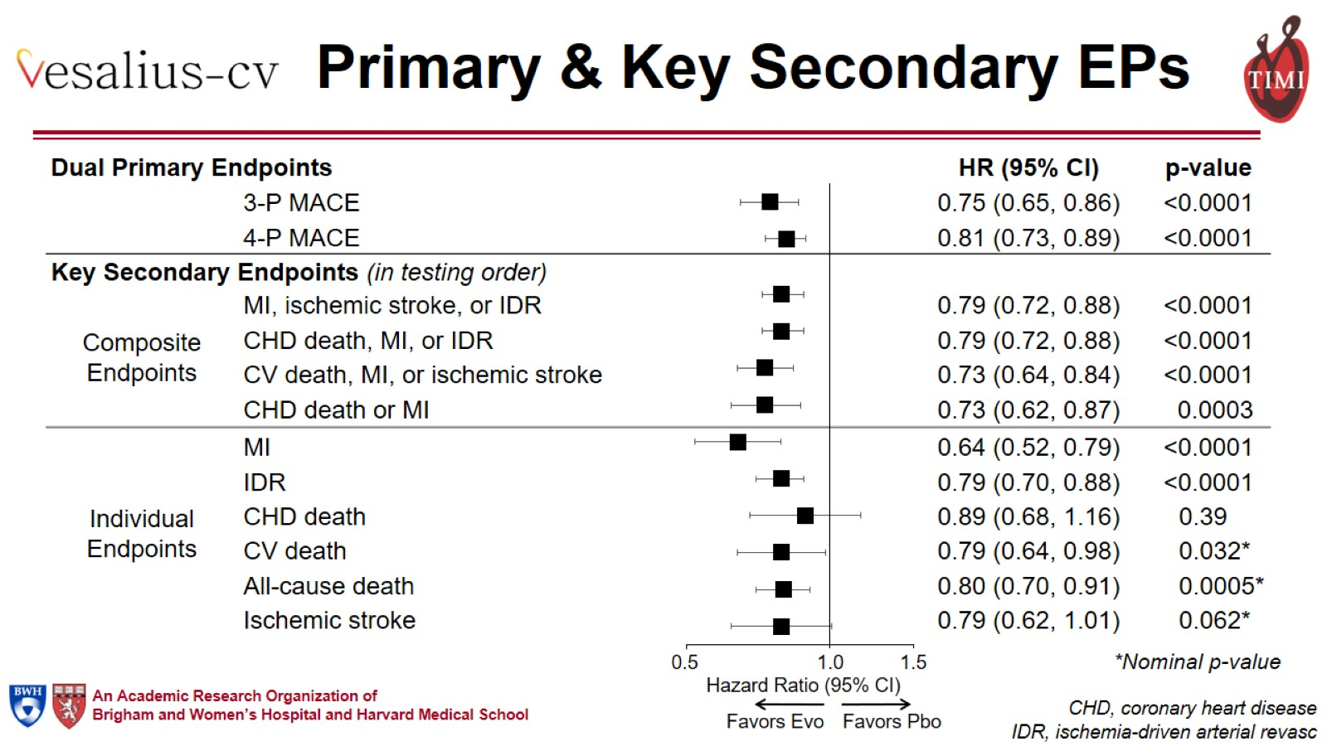
Primary & Key Secondary EPs

Slide 13
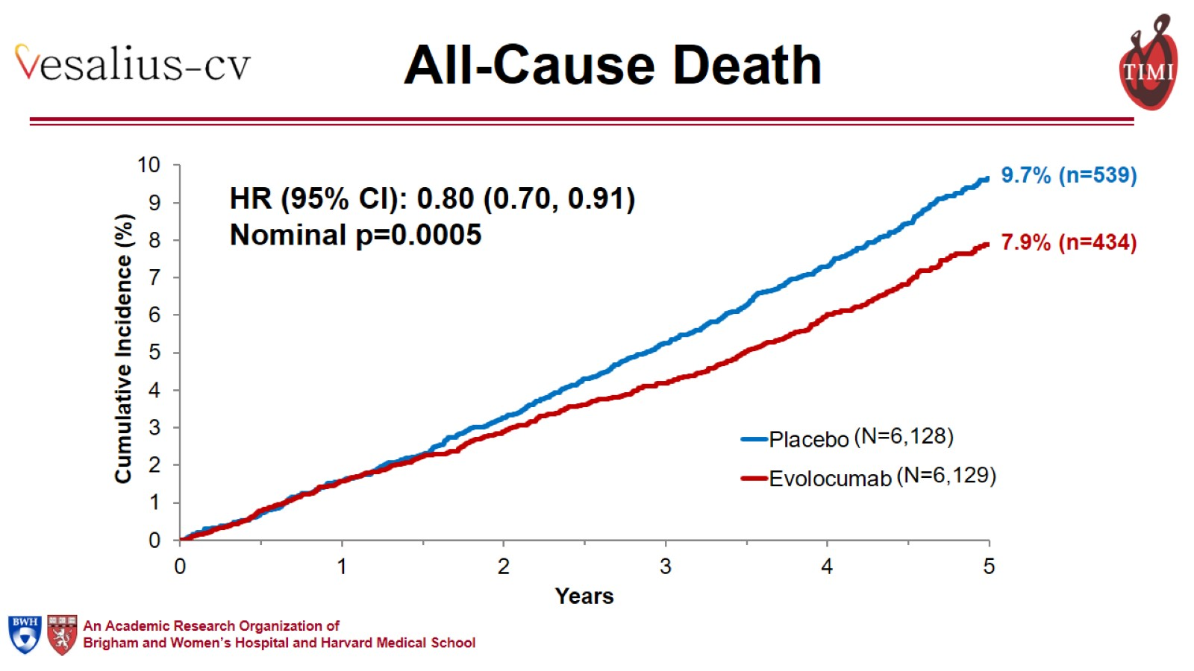
All-Cause Death

Slide 14
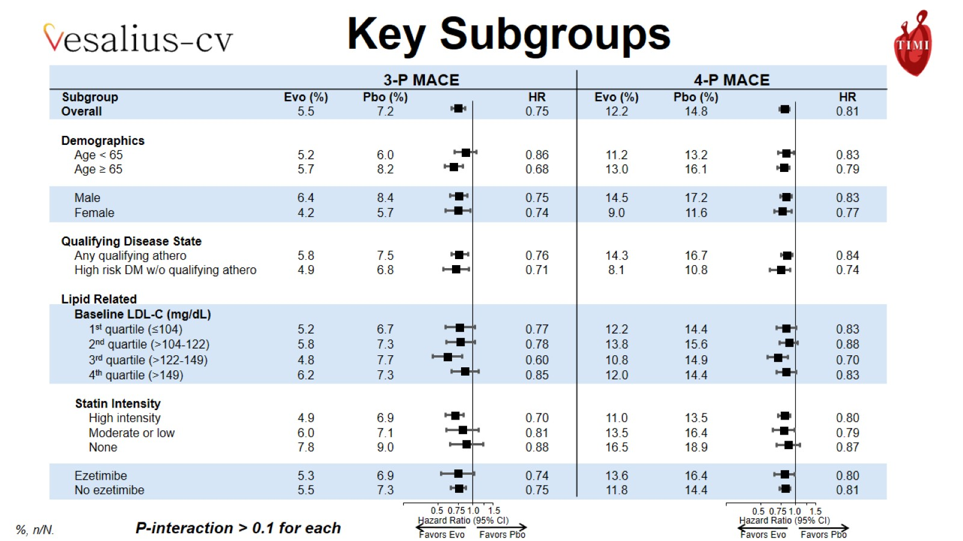

Slide 15
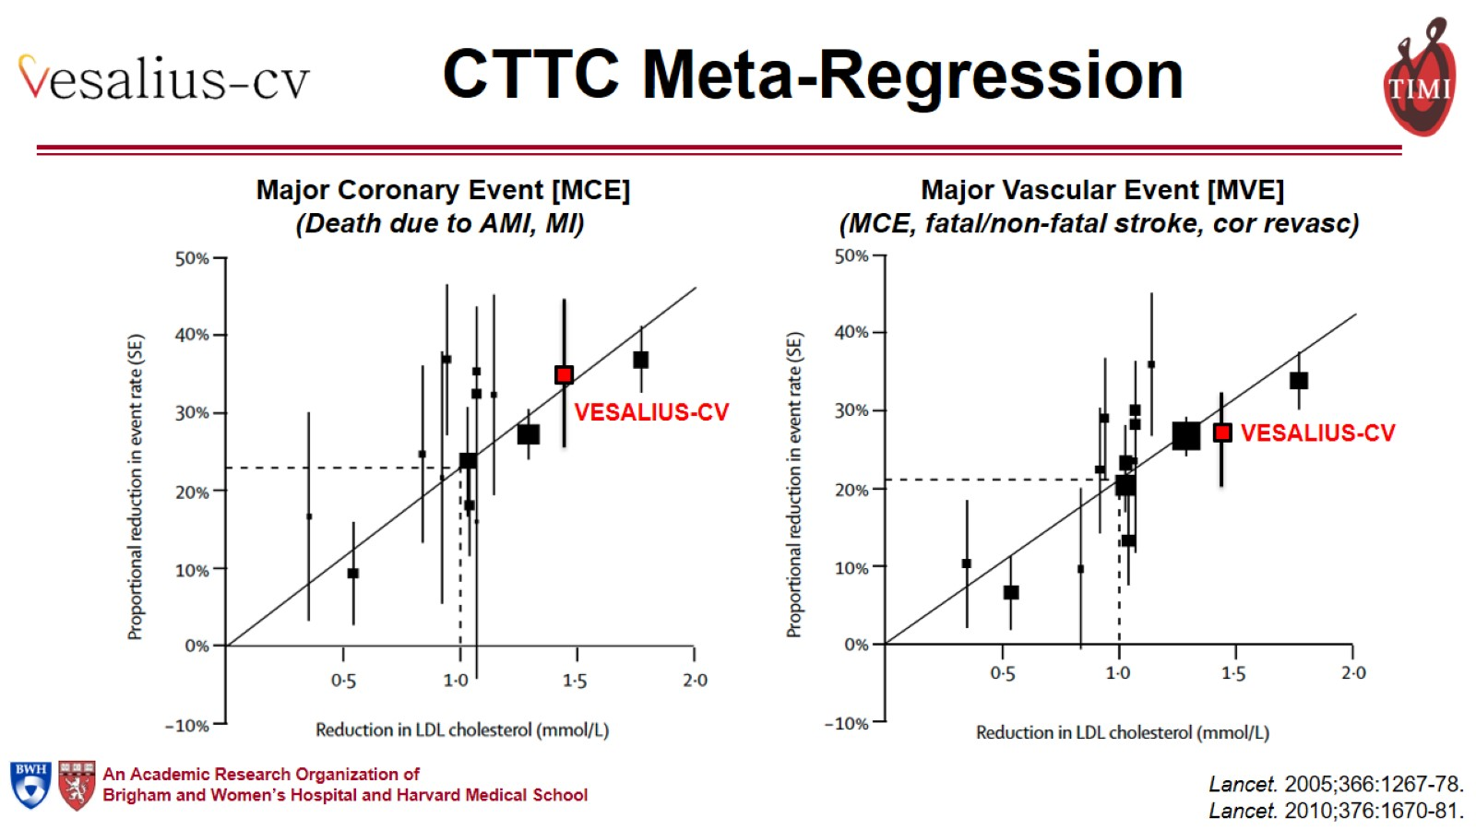
CTTC Meta-Regression

Slide 16
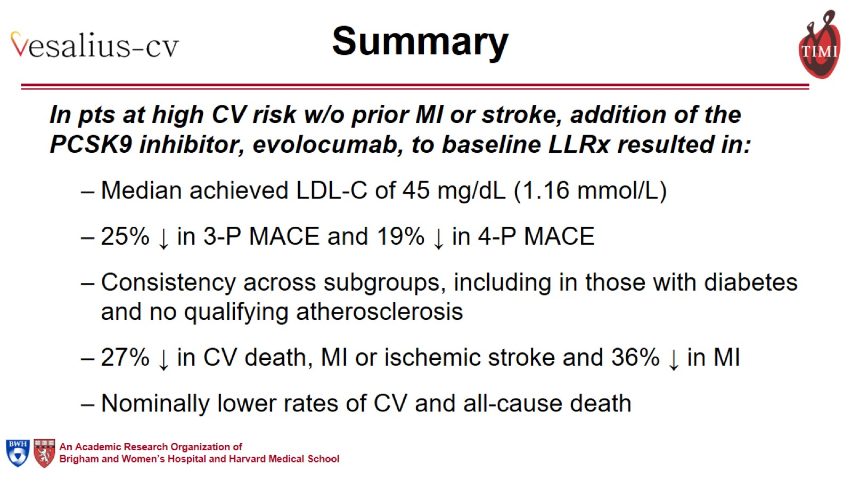
Summary

Slide 17
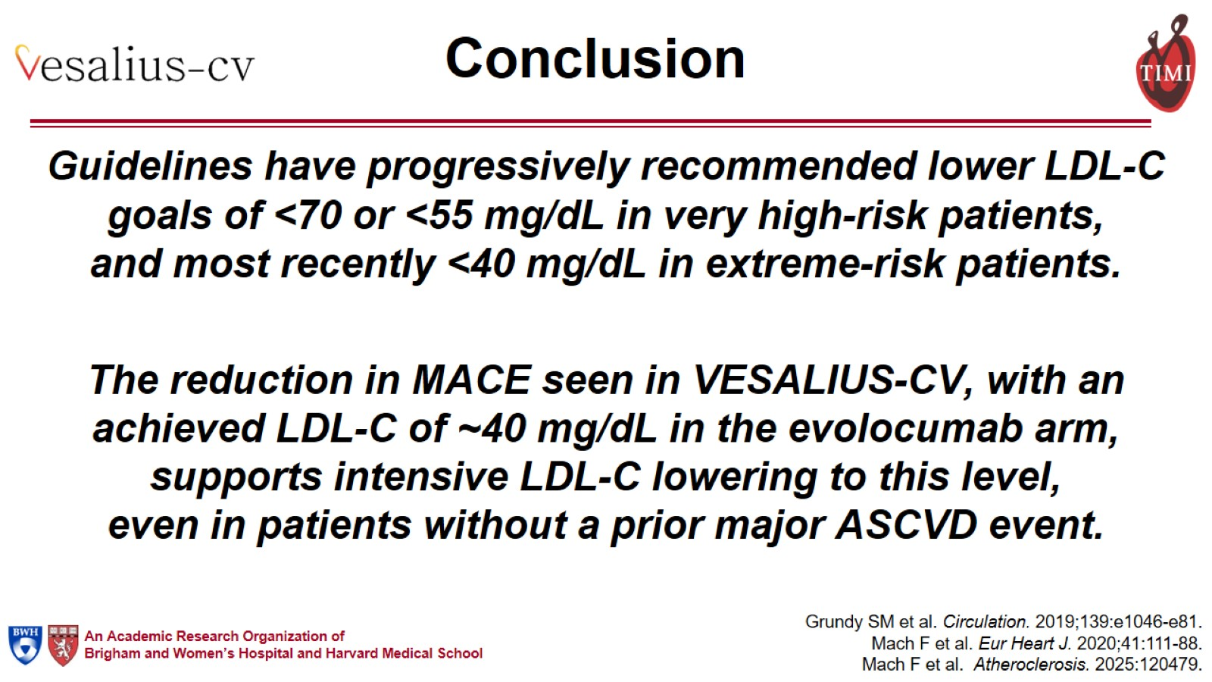
Conclusion

Slide 18
